Slide 1
Predict Purchasing Capacity of the customers

Slide 2
Objective: The objective of customer capacity planning is to optimize resource allocation to efficiently handle customer demand. It ensures scalability, cost-effectiveness, and service quality while preventing underutilization or overload. The goal is to balance operational efficiency with customer satisfaction through data-driven forecasting and strategic planning. Benefits: Optimized Resource Utilization – Avoids over/underuse of resources. Improved Customer Satisfaction – Ensures timely service and support. Cost Efficiency – Reduces unnecessary expenses and maximizes ROI. Scalability & Growth – Supports future demand without disruptions.

Slide 3
Data Sharing Agreement :
Sample file name ("Customer_purchasing - Copy.csv")
Length of date stamp( 11251 )
Length of time stamp(2024, 23,25)
Number of Columns :- 23
Column names :-
'User_ID', 'Cust_name', 'Category', 'Item', 'Price Per Unit', 'Quantity', 'Total Spent', 'Gender', 'Age Group', 'Age', 'Marital_Status', 'State', 'Zone', 'Occupation', 'Income', 'Location', 'Product_Category', 'Orders', 'Amount', 'Transaction Date', 'Payment Method', 'Status', 'unnamed1'], dtype='object')
Column data type :- INT, FLOAT,STRING
11

Slide 4
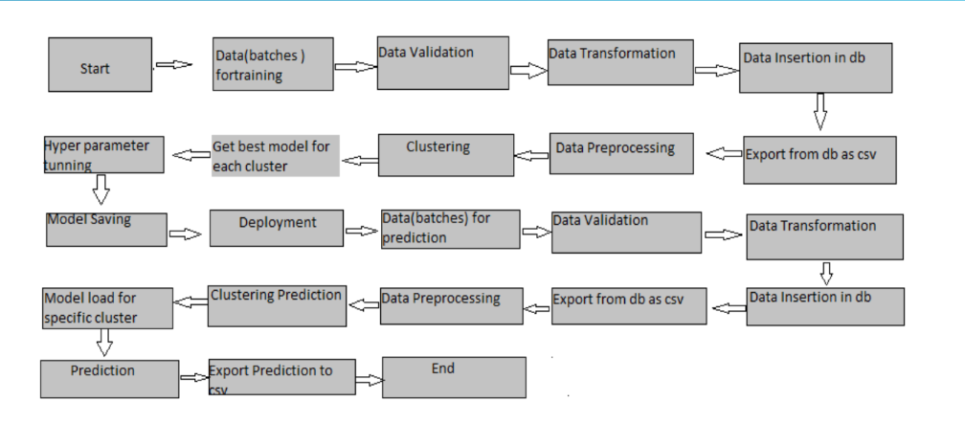
Architecture

Slide 5
STEPS
Model Training:
Data Export from Db :
The accumulated data from db is exported in csv format for model training
Data Preprocessing
Performing EDA to get insight of data like identifying distribution , outliers ,trend
among data etc.
Check for null values in the columns. If present impute the null values.
Encode the categorical values with numeric values.
Perform Standard Scalar to scale down the values.

Slide 6
Clustering –
KMeans algorithm is used to create clusters in the preprocessed data. The
optimum number of clusters is selected by plotting the elbow plot, and for the
dynamic selection of the number of clusters, we are using KneeLocator
function. The idea behind clustering is to implement different algorithms on
the structured data
The Kmeans model is trained over preprocessed data, and the model is saved
for further use in prediction
Model Selection –
After the clusters are created, we find the best model for each cluster. By using 2
algorithms “SVM” and "XGBoost". For each cluster both the hyper tunned
algorithms are used. We calculate the AUC scores for both models and select the
model with the best score. Similarly, the model is selected for each cluster. All
the models for every cluster are saved for use in prediction

Slide 7
Prediction:
The testing files are shared in the batches and we perform the same Validation
operations ,data transformation and data insertion on them.
The accumulated data from db is exported in csv format for prediction
We perform data pre-processing techniques on it.
KMeans model created during training is loaded and clusters for the preprocessed
data is predicted
Based on the cluster number respective model is loaded and is used to predict the
data for that cluster.
Once the prediction is done for all the clusters. The predictions are saved in csv
format and shared.

Slide 8
Q & A:
Q1) What’s the source of data?
The data for training is provided by the client in multiple batches and each batch contain multiple files
Q 2) What was the type of data?
The data was the combination of numerical and Categorical values.
Q 3) What’s the complete flow you followed in this Project?
Refer slide 5th for better Understanding
Q 4) After the File validation what you do with incompatible file or files which didn’t pass the validation?
Files like these are moved to the Achieve Folder and a list of these files has been
shared with the client and we removed the bad data folder.

Slide 9
Q 5) How logs are managed?
We are using different logs as per the steps that we follow in validation and
modeling like File validation log , Data Insertion ,Model Training log , prediction log etc.
Q 6) What techniques were you using for data pre-processing?
Removing unwanted attributes
Visualizing relation of independent variables with each other and output variables
Checking and changing Distribution of continuous values
Removing outliers
Cleaning data and imputing if null values are present.
Converting categorical data into numeric values.
Scaling the data

Slide 10
Q 7) How training was done or what models were used?
Before diving the data in training and validation set we performed clustering over fit to divide the data into
clusters.
As per cluster the training and validation data were divided.
The scaling was performed over training and validation data
Algorithms like SVM , XGBoost were used based on the recall final model was used for each cluster and we
saved that model .
Q 8) How Prediction was done?
The testing files are shared by the client .We Perform the same life cycle till the data is clustered .Then on the basis
of cluster number model is loaded and perform prediction. In the end we get the accumulated data of predictions.

